Slide 1

Python –MySQL database connectivity

Slide 2
Relational Databases
Relational databases are a powerful, flexible way to store and retrieve many kinds of data.
There are many relational database implementations, which vary in scala bility and richness of features.
The standard libraries do not include relational database support; however, Python modules exist to access almost any relational database, including Oracle, MySQL, DB/2, and Sybase.
The Python Database API defines a standard interface for Python modules that access a relational database.

Slide 3
DB API
The DB API provides a minimal standard for working with databases, using Python structures and syn tax wherever possible. This API includes the following:
  Connections, which cover guidelines for how to connect to databases
  Executing statements to query, update, insert, and delete data with cursors
  Transactions, with support for committing or rolling back a transaction
  Examining metadata on the database module as well as on database and table structure

Slide 4
Connection Objects
The connect method constructs a database connection.
The connection is used in constructing cursors. When finished with a connection, call its close method to free it.
Databases generally provide a limited pool of connections, so a program should not needlessly use them up.
The parameters of the connect method vary by module, but typically include dsn (data source name), user, password, host, and database.

Slide 5
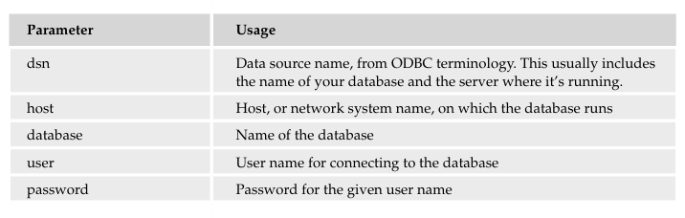
Connection Object Parameters

Slide 6
Transactions
A transaction is a collection of actions that must execute atomically
a bank transfer might debit one account and credit another; this should be done within a single transaction, as performing only one half of the transfer would obviously be unacceptable.
Calling the commit connection method completes the current transaction; calling rollback cancels the current transaction.
Not all databases support transactions— for example, Oracle does, MySQL doesn’t

Slide 7
Cursor objects
A cursor can execute SQL statements and retrieve data.
The connection method cursor creates and returns a new cursor.
The cursor method execute(command [,parameters]) executes the specified SQL statement command, passing any necessary parameters.
After executing a command that affects row data, the cursor attribute rowcount indicates the number of rows altered or returned;
After executing a command that selects data, the method fetchone returns the next row of data
The method fetchmany([size]) returns a sequence of rows—up to size of them.
The method fetchall returns all the rows.

Slide 8
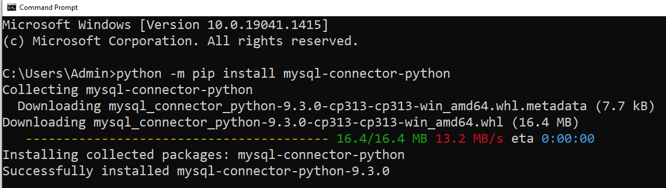
Connecting to a MYSQL database
To connect to a mysql database we need a connector which can be downloaded by the following steps:
Open the command prompt-> Type the following command in the windows command prompt:
  python -m pip install mysql-connector-python

Slide 9
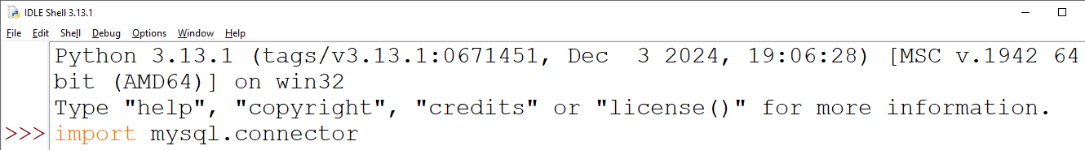
To check whether the python interface is connected or not open the python IDLE & type
  import mysql.connector
If there is not error after executing this command then the mysql connector is installed successfully.

Slide 10
Program to Connect and print the Database
import mysql.connector
mydb = mysql.connector.connect(
host="localhost",
user="root",
password="root",
database="bcadb")
print(mydb)
mycursor = mydb.cursor()
mycursor.execute("CREATE DATABASE mydatabase")
mycursor.execute("SHOW DATABASES")
for x in mycursor:
print(x)

Slide 11
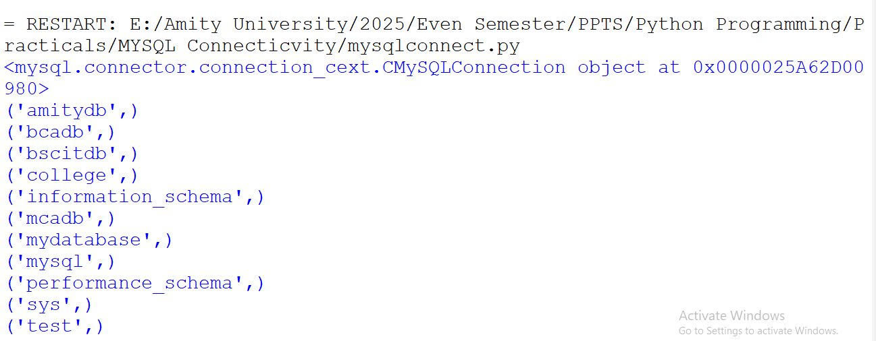
Output

Slide 12
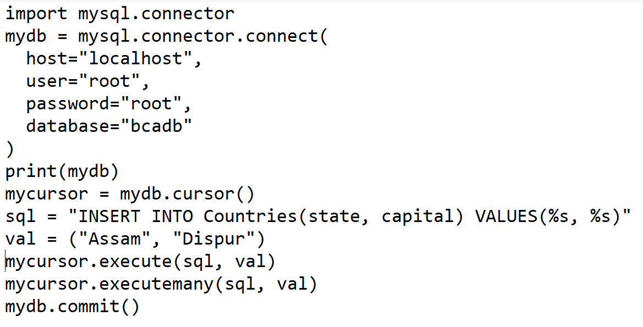
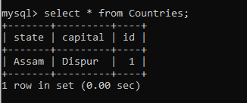
Inserting Records in a Table

Slide 13
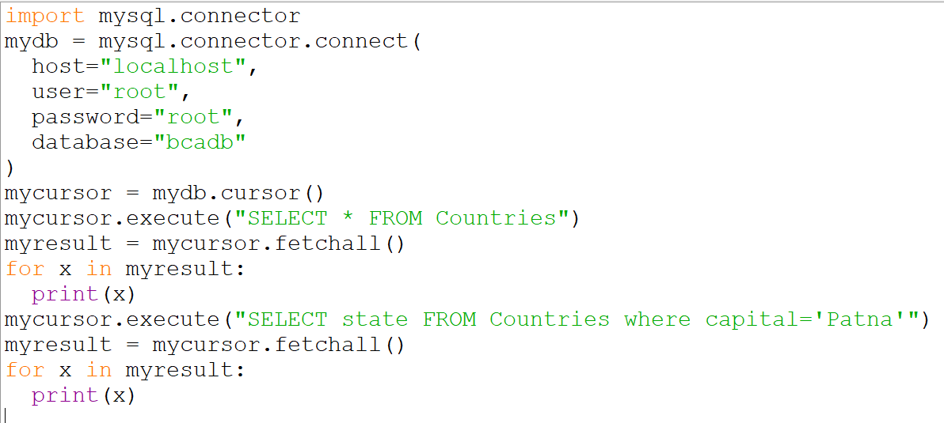
Selecting Records

Slide 14
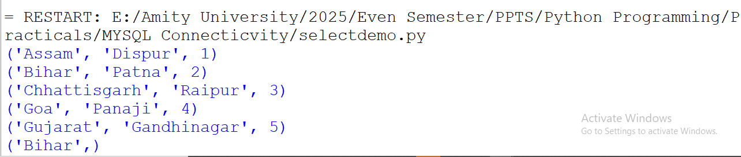
Output

Slide 15
The End!

